Slide 1

Finance/Telecom Project Loan Default

Slide 2
Project Overview
Financial loan services are leveraged by companies across many industries, from big banks to financial institutions to government loans. One of the primary objectives of companies with financial loan services is to decrease payment defaults and ensure that individuals are paying back their loans as expected. In order to do this efficiently and systematically, many companies build analysis model to predict which individuals are at the highest risk of defaulting on their loans, so that proper interventions can be effectively deployed to the right audience.
This dataset has been taken from Coursera's Loan Default Prediction Challenge, which contains 255,347 rows and 18 columns in total.

Slide 3
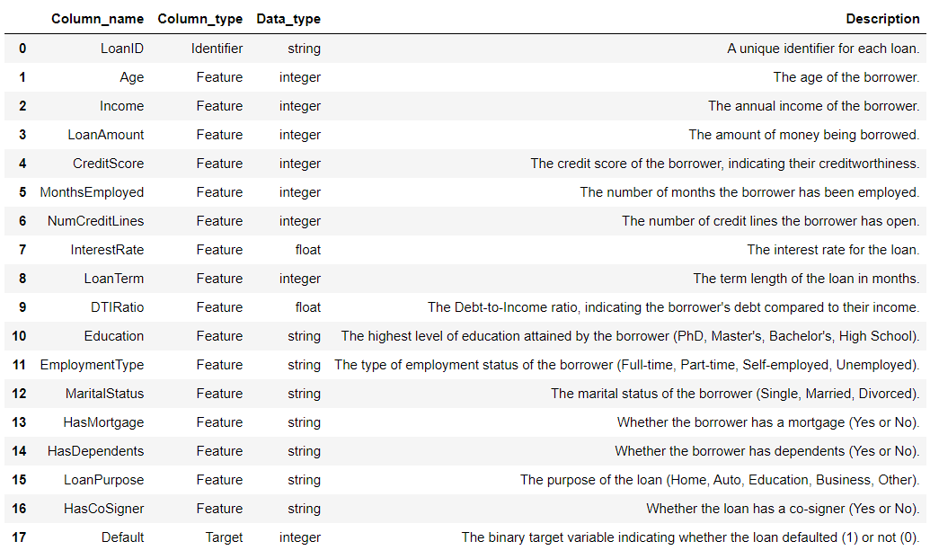
Data Features

Slide 4
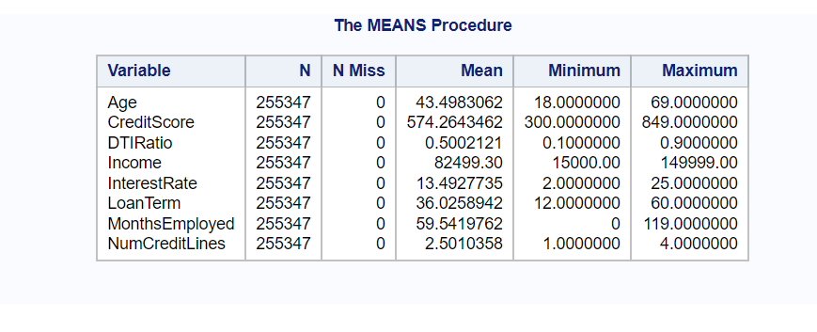
Numerical variables

Slide 5
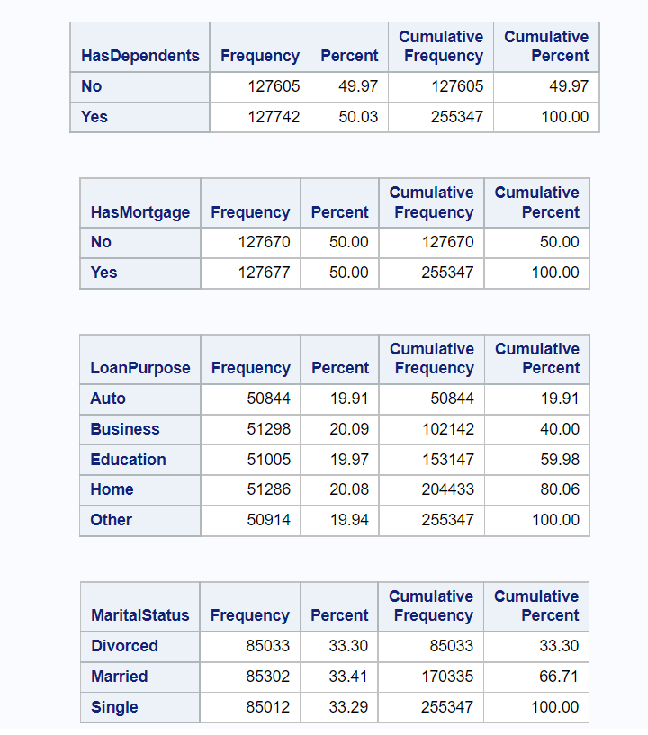
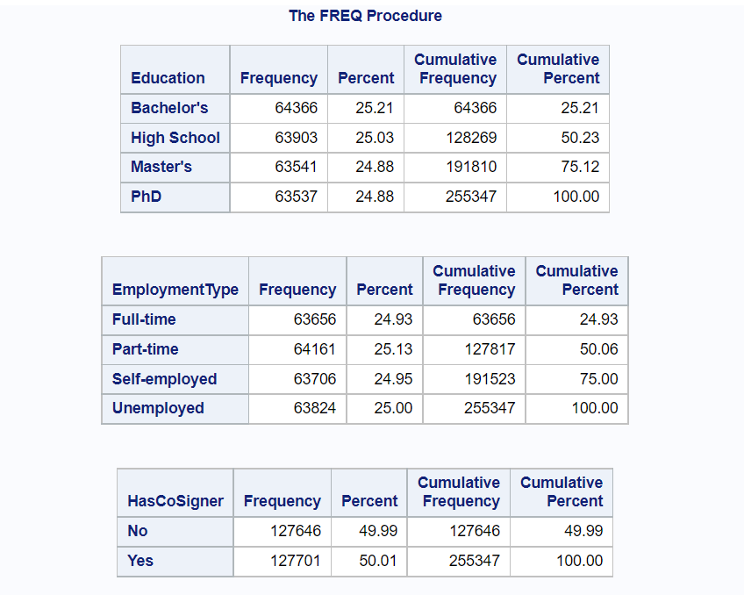
Categorical variables

Slide 6
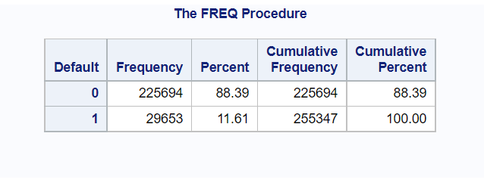
Default

Slide 7
Train dataset and Test dataset
Random select 75000 observations.
Default: 1:0 = 2:8
Train : Test = 7:3
Train : 52500 observation
Test: 22500 observation

Slide 8
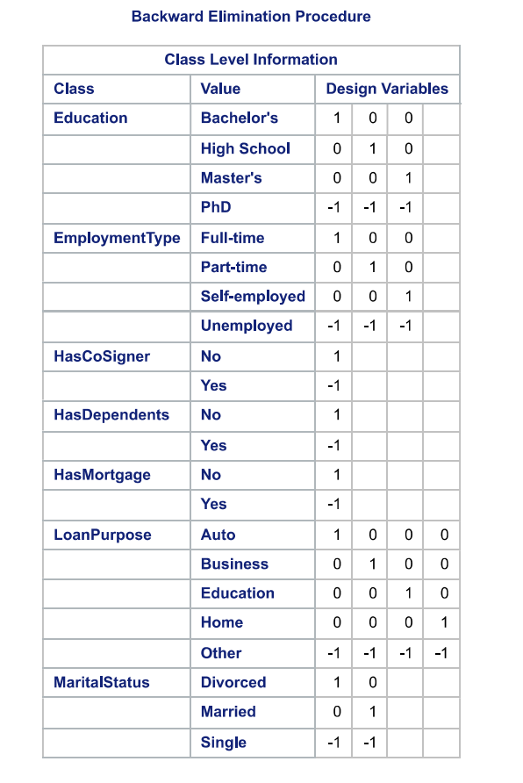
LOGISTIC Procedure

Slide 9
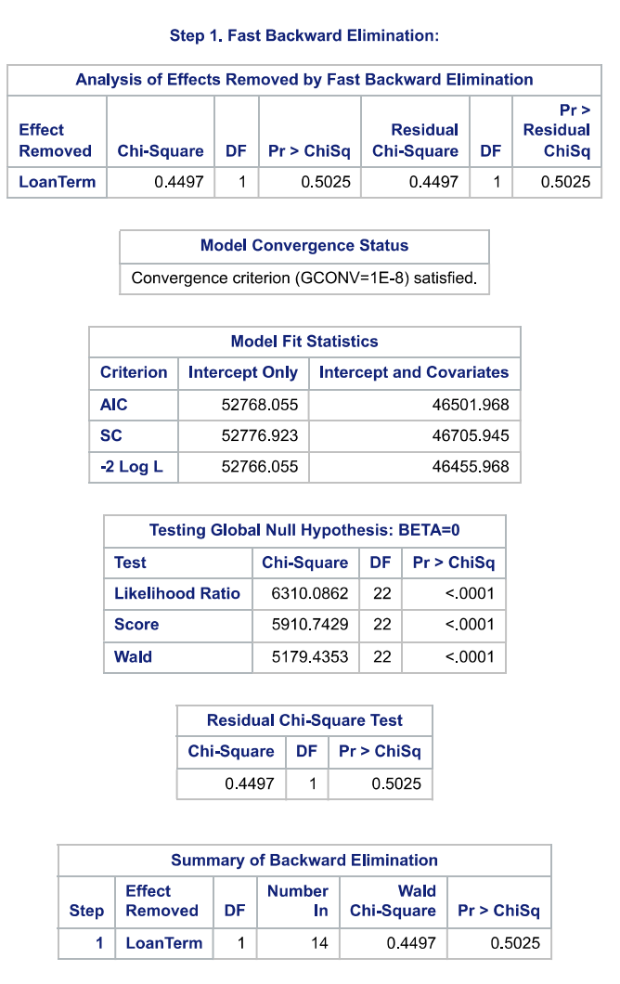
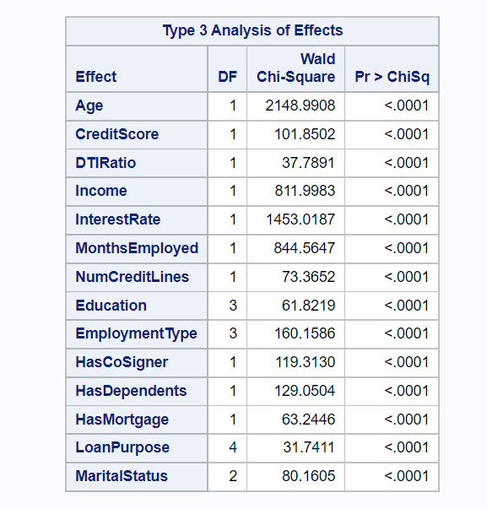
LOGISTIC Procedure

Slide 10
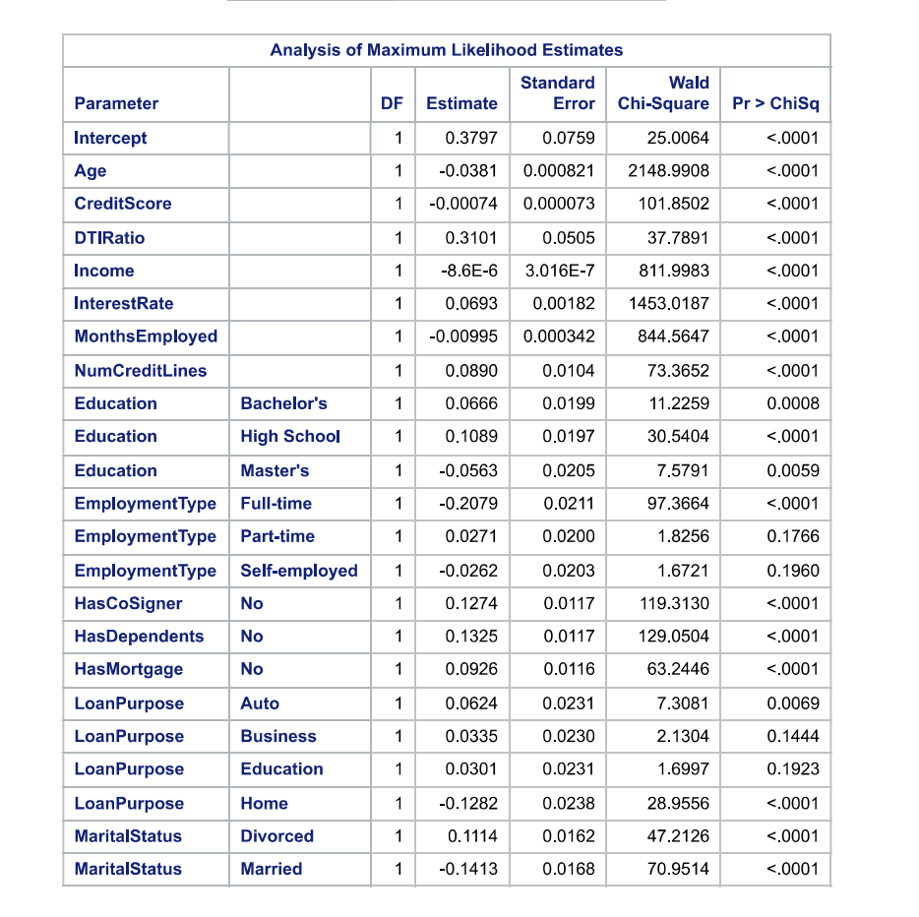
LOGISTIC Procedure

Slide 11
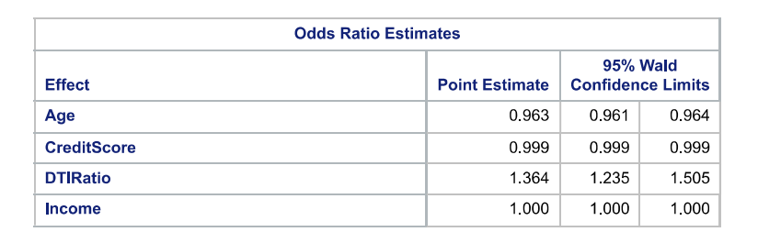
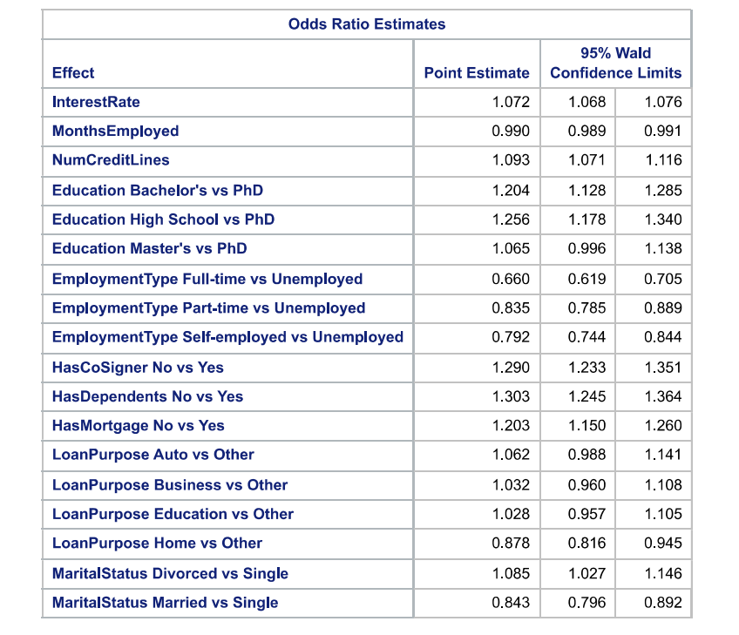
LOGISTIC Procedure

Slide 12
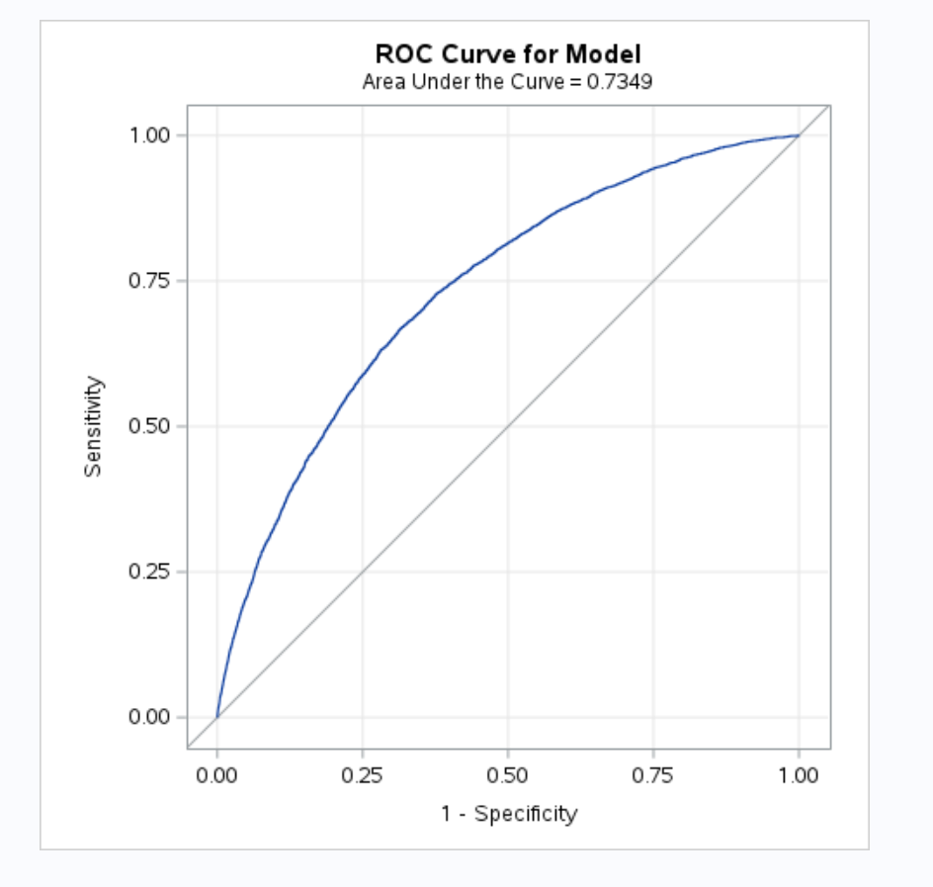
ROC Curve

Slide 13
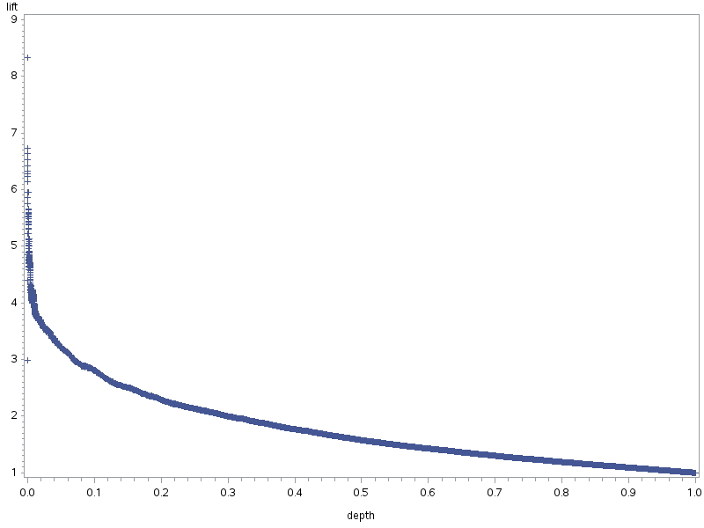
LIFT

